Slide 1


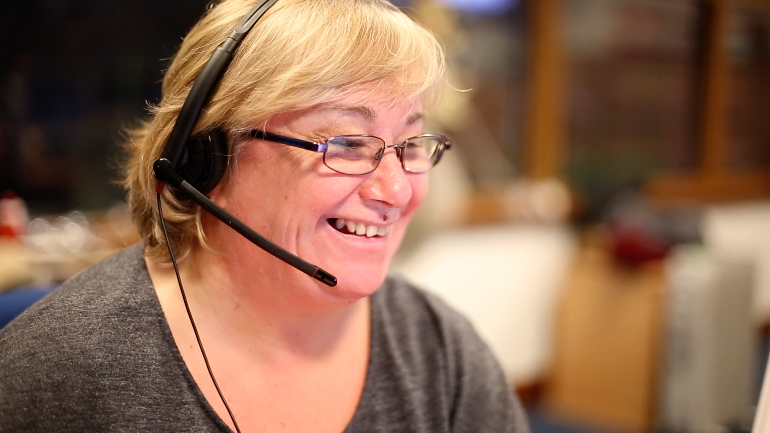

Members’ Seminar
Member Zone, Considerations a Year On.
October 2023
Topics today:
MZ Request Portal
MZ Resource Portal
The Benefits of MZ
MZ Evolution and Improvement
MZ Our Asks

Slide 2
Member Zone – Request Portal
1603 Service Requests have been logged on MZ since it went live in June 2022. 78% of these were logged by members using the MZ self service portal.
78% (1246) of requests were for Roads and Infrastructure Services. 641(51%)of these were standard queries requestable on the website.
1398 requests have been responded to and 205 are in progress. The average working days for an initial response is 2.8 for RIS and 8.5 for other Services. The average number of days for a full resolution response is 20.8 for RIS and 14 for other Services.
Member feedback on quality of response shows:
- 89% Satisfaction on timeliness of response (79 responses)
- 91% Satisfaction on quality of response (90 responses)
15 Members have logged up to 30 requests.
15 Members have logged 30-69 requests
6 Members have logged 70+ requests
579 requests are with members for action – status “Follow up Response Provided”. Most should be closed.

Slide 3
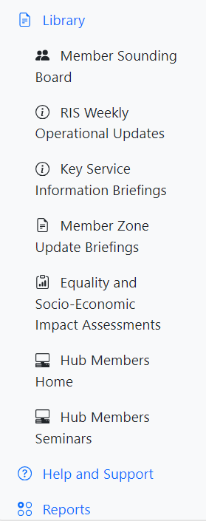
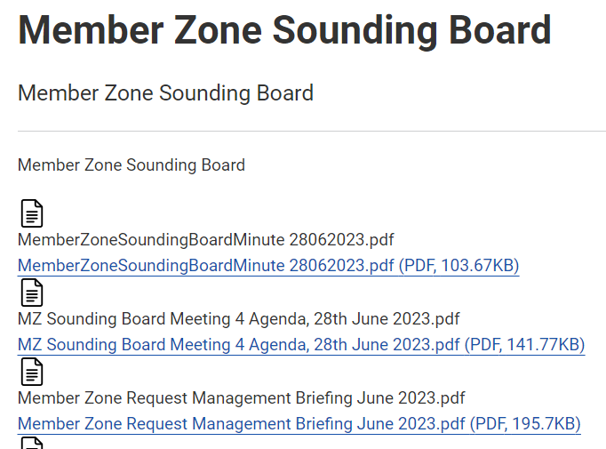
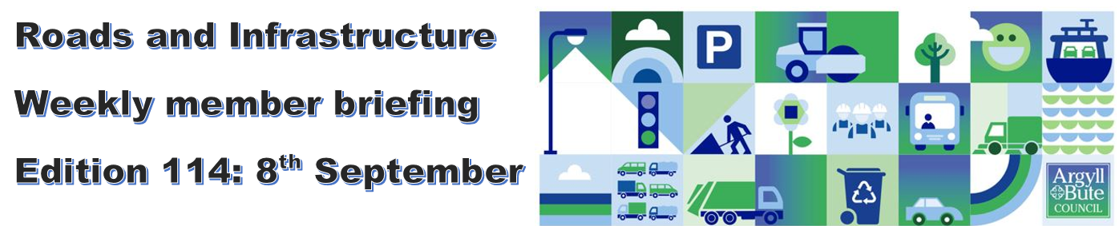
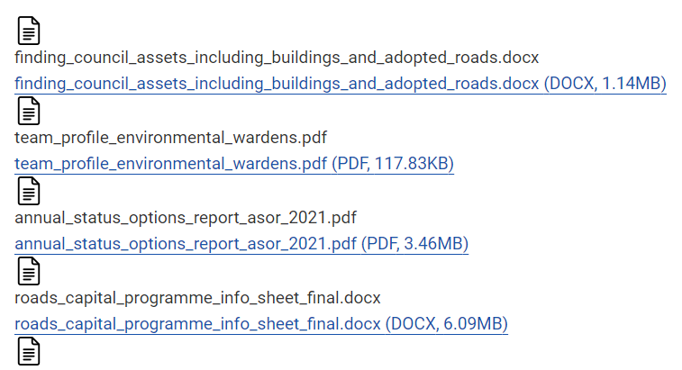
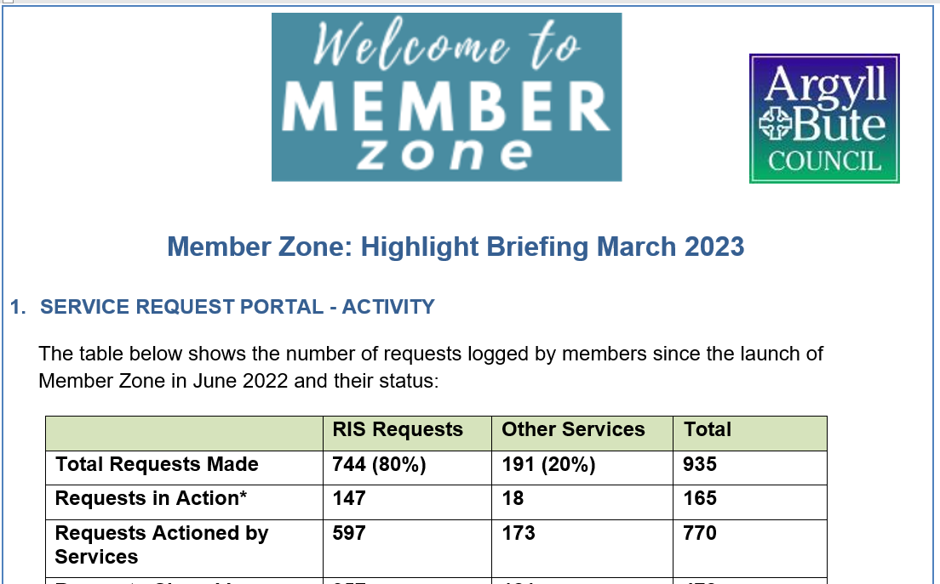
Member Zone – Resource Portal (1)
In addition to raising/managing service requests MZ has many useful resources….

Slide 4
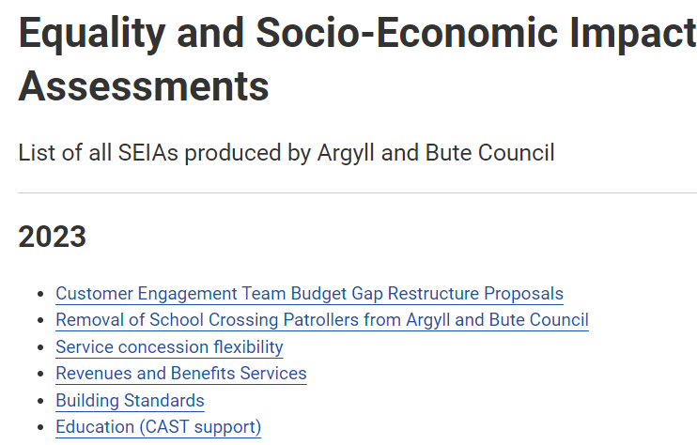
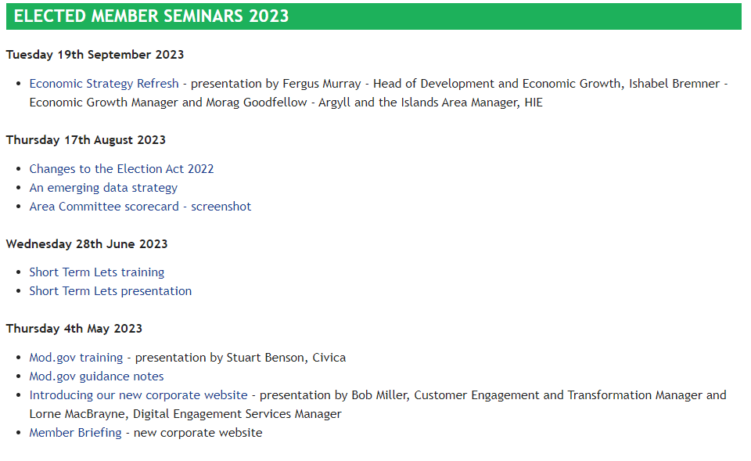
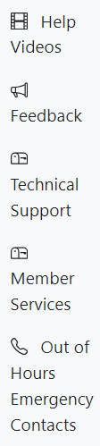
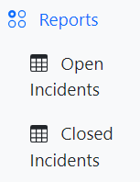
Member Zone – Resource Portal (2)
In addition to raising/managing service requests MZ has many useful resources….

Slide 5
The Benefits of Member Zone
It provides members with a single place to log and track all their constituents’ enquiries and it gives information on their activity to report back to constituents and Community Councils.
It feeds requests to Services in a structured way so they can meet member and customer needs efficiently and accountably.
Self service by members frees up officer time to help in other ways
It allows Senior Management and MZ Sounding Board oversight of how well the Services are performing in meeting member needs. Off piste requests have no such visibility.
It provides a variety of other resources to help members conduct their business effectively; particularly important for new members.
It is always improving – guided by member input.

Slide 6
Member Zone – Evolution
MZ was always intended to improve, driven by member input and feedback. Here are some improvements already implemented:
Caseload Management
New open / closed incidents views
Improved incident search option
Option for fortnightly recent activity reports
New constituent details and community council fields added to all forms
Link to council organisation structure on new enquiry page
Date last viewed added to report views
Auto closure of incidents (14 so far)
Service Requests:
New form for members to log and track non-council enquiries
Option to mark enquiry as urgent
Option to email details of enquiry
New dedicated form for Planning/Building Standards enquiries
Option to share enquiry with other members in ward
Option to print/save requests as pdfs
New escalation process including auto escalation if SLA exceeded by 20+ days
General Improvements:
Two Factor Authentication Security
New menu layout to improve user experience
Library of key documents added
Quality and timeliness related feedback survey on closure of service requests
Links to previous member seminars added
MZ Suggestion Form added
All new suggestions welcome ... We are currently working on colour coding service requests by priority and improving the feedback survey. What are your asks of us?

Slide 7
Member Zone – Our 6 Asks
MZ like all systems needs its users to operate it correctly if it is to work effectively for them, so I have some asks:
Please enrol for the more secure Two Factor Authentication on the national MyAccount gateway, which protects both your data and that of your constituents.
Try to encourage constituents to log standard RIS requests using Request It and Report It functions on the website. It saves much resource and is better for them.
Please review your open Service Requests sitting at ‘Follow Up Response Provided’ and close the ones where the Service has responded and no further action is required. This can be done by marking the case ‘Resolved’ and it will make your active caseload far more manageable.
Only use the “Urgent” flag on a service request when absolutely necessary e.g. the response is critically time bound. Of the 124 urgents, 61 were by a single member. Remember, there are alternative ways to raise dangerous or contentious matters.
If you are one of the 15 low usage users of Member Zone, please give it another go. There have been many member driven enhancements over the past year and going direct to officers wastes resources and is unfair to colleagues who use the MZ service.
Be “critical friends” to MZ, join the Sounding Board or give us constructive suggestions in other ways, so we can continue to best meet the needs of members.

Slide 8
Members’ Seminar
Member Zone, Considerations a Year On
October 2023
Questions/Discussion ?

